Slide 1

A Comparative Study of CNN Baseline Classifier and LLM-Based Model for Medical Visual Question Answersing
Name (Matric Number) | ZOU TING (24201617) ZHONG JUNPEI(24214748)
Course | WOA7015 – Advanced Machine Learning
Lecturer Name | Dr. SAW SHIER NEE (OCC1)

Slide 2

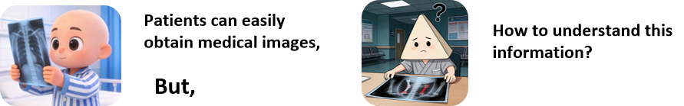
Introduction
Demands for "understanding medical images"
how to evaluate the performance of closed-ended and open-ended questions？
Notes:
we will address this topic through the following four aspects, and will discuss several key questions among them.

Slide 3
RQs/ROs
RQs
ROs
RQ1 (Closed-Ended Performance): Which model that we choose to compare performs better on closed-ended questions in radiology and how large is the performance gap?
To evaluate the traditional CNN-based baseline and a generative Vision-Language Model (VLM) using accuracy metric for closed-end questions and critically discuss the gap of these two model.
RQ2 (Open-Ended Quality and Safety): How well do generative VLMs perform on open-ended medical questions, and what is the risk of hallucinated answers?
To evaluate answer quality using automated language similarity metrics such as BLEU-1, BLEU-4, BERTScore and qualitative analysis and compare the results with benchmarks.
Notes:
we will address this topic through the following four aspects, and will discuss several key questions among them.

Slide 4
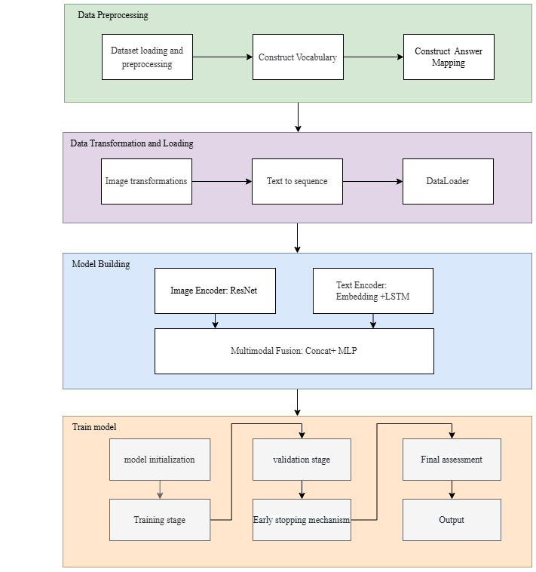
Methods-baseline architecture
A. Data Preprocessing
train
validate
test
70%
15%
15%
Vocabulary construction
Answer mapping
Notes:
we will address this topic through the following four aspects, and will discuss several key questions among them.

Slide 5
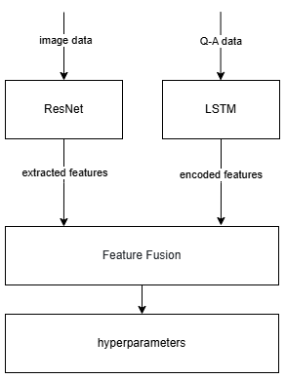
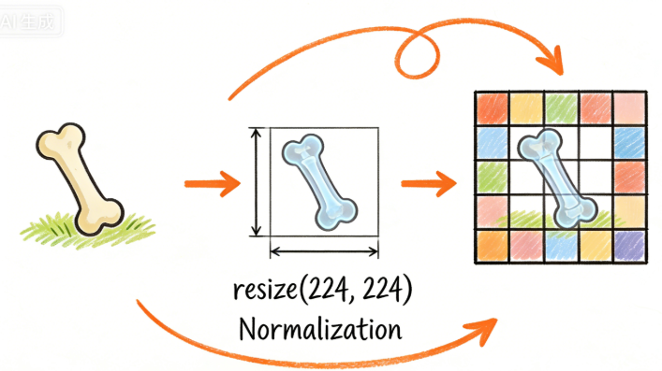


Methods-baseline architecture
B. Data Transformation and Loading
C. Model Building(MedVQA_ResNet_LSTM)
1. Image transformations
2. Text serialization
max_seq_len=25
3. DataLoader
batch = 32
processes = 2(GPU)
Notes:
we will address this topic through the following four aspects, and will discuss several key questions among them.

Slide 6
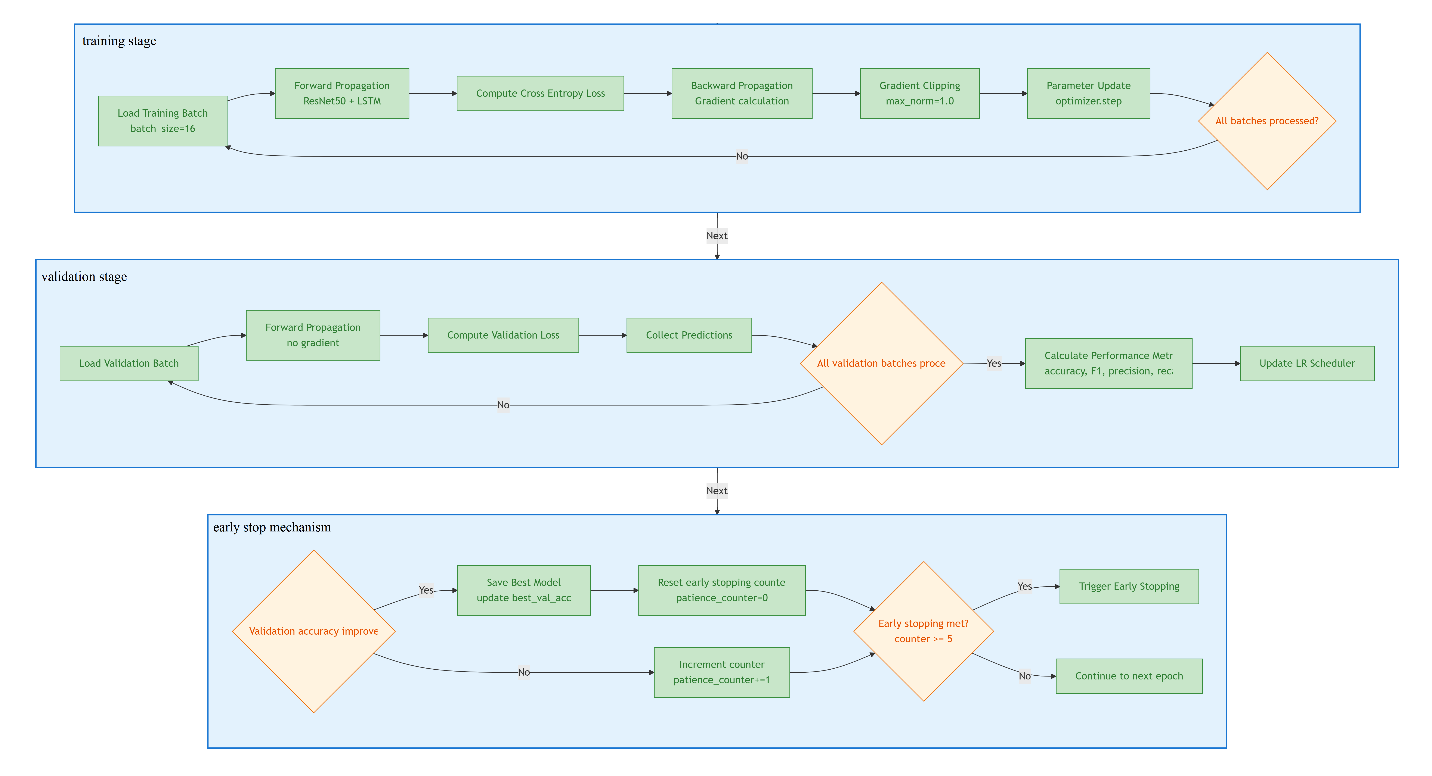
Methods-baseline architecture
D. Training Pipeline
all batch procceed
1. training stage
ACC,F1
LR
2. validation stage
patience check
3. early stop mechanism
Notes:
we will address this topic through the following four aspects, and will discuss several key questions among them.

Slide 7
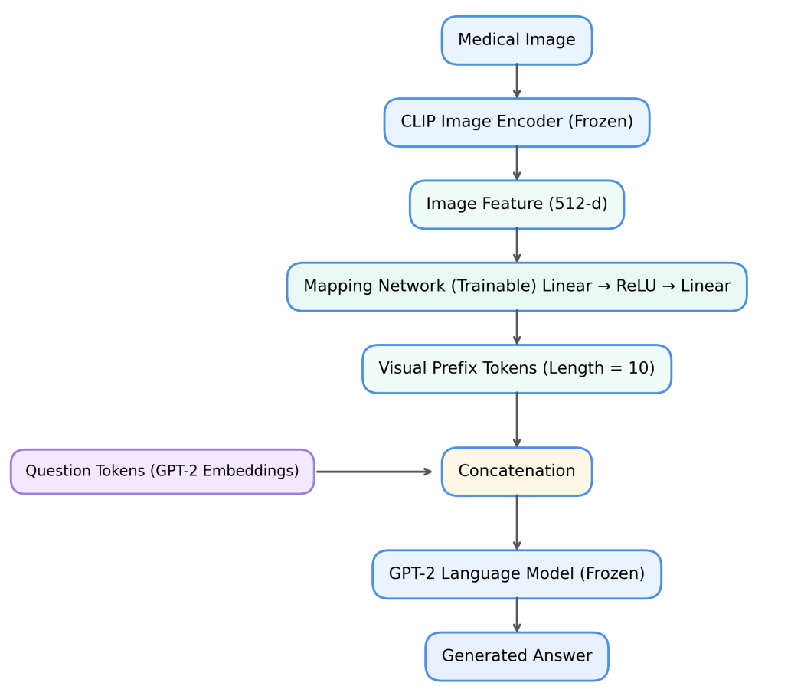
Methods-Generative Model Architecture
Dataset: 80% training, 20% testing
Key Components:
CLIP Image Encoder (frozen) : outputs 512-d image feature vectors.
Mapping Network (trainable) : two-layer linear network with ReLU activation projecting CLIP features to GPT-2 embedding space, generating 10 visual prefix tokens.
GPT-2 Language Model (frozen) : receives concatenated visual prefixes and question embeddings for answer generation.
Notes:
we will address this topic through the following four aspects, and will discuss several key questions among them.

Slide 8
Methods-Generative Model Architecture
Metric used for analyzing generative model
Mertic | Question Type | Focus
Accuracy | Closed | Diagnostic correctness
BLUE | Open | Language quality
BERTScore | Open | Semantic similarity
Accuracy fails for open-ended questions because semantically correct answers with different wording are treated as completely wrong.
Why Accuracy is not used for Open-end questions ?
Reference Answer | Model Prediction | Accuracy Result | Reality
"the brain" | "brain" | Incorrect (0) | Same clinical meaning
Notes:
we will address this topic through the following four aspects, and will discuss several key questions among them.

Slide 9
Methods-Generative Model Architecture
Internal Comparison:
Comparison with baseline model (classifier), Focusing on:
      How about the gap of performance for closed questions?
External Comparison:
Comparison with results from Sonsbeek et al. (2023), Foucusing on:
      What is the gap of ours with Sonsbeek et al. ?
      Why is the gap ?
Notes:
we will address this topic through the following four aspects, and will discuss several key questions among them.

Slide 10
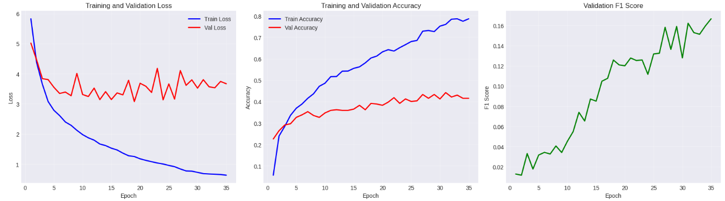
Result-baseline
Parameter | Value
Epochs | 35
Batch Size | 16
Optimizer | Adam
Learning Rate | 10^(-4)
Dropout | 0.3
Metric | Training Set | Validation Set | Test Set
Accuracy | 78.65% | 44.21% | 33.83%
F1 Score | - | 16.21% | 13.64%
Precision | - | 16.04% | 14.54%
Recall | - | - | 13.27%
Loss | 0.6623 | 3.8041 | -
Learnable
Overfitting
Notes:
we will address this topic through the following four aspects, and will discuss several key questions among them.

Slide 11
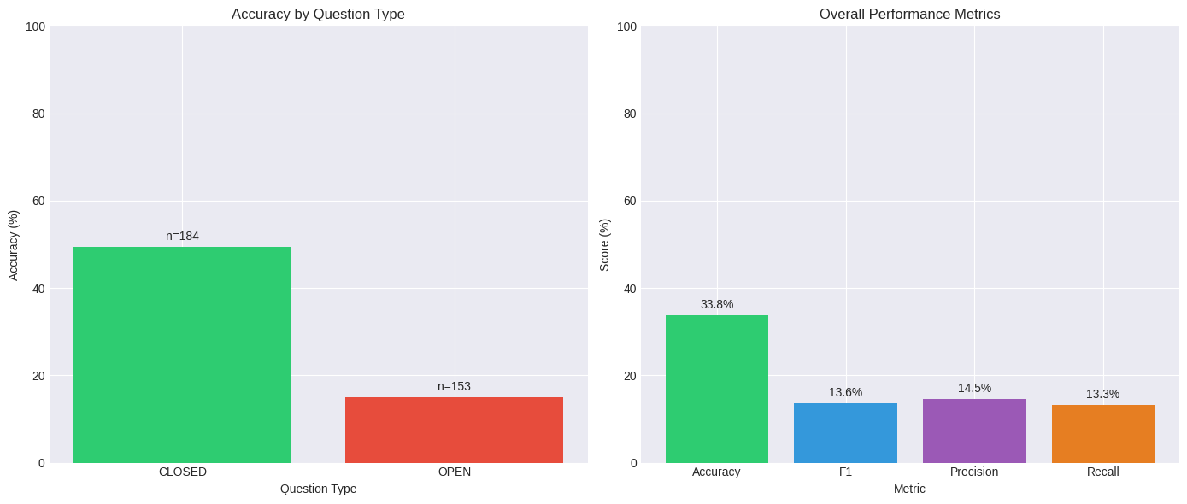
Result-baseline
better CLOSED question
Low generalization ability
Category imbalance
Notes:
we will address this topic through the following four aspects, and will discuss several key questions among them.

Slide 12
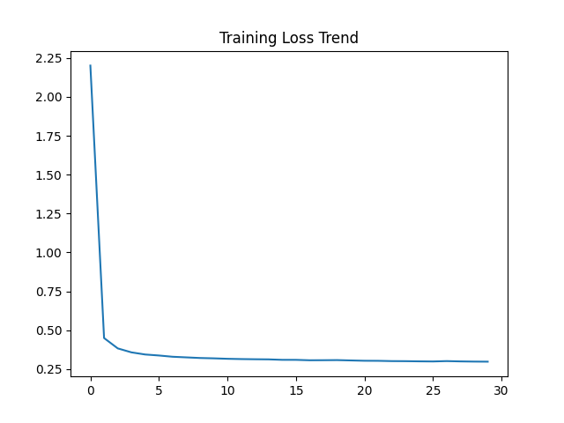
Result-Generative Model
Core Contradiction
  Finding: a rapid decline in the initial stage and the loss curve enters a plateau after Epoch 5
  Why quickly decline ?
  CLIP and GPT-2 are pre-trained and frozen
  What has been proved?
  Learning rate (1e-4) and AdamW optimizer appropriately set
Question Type | Accuracy | BLEU-1 | BERTScore-F1
Closed-Ended Questions | 63.03% | – | –
Open-Ended Questions | – | 0.084 | 0.911
Overall | 36.00% | – | –

Slide 13
Result-Generative Model
Experimental Differences and Impact
Longer and fixed-length sequences (lx = 10, lq/la = 128) : dilute the injection of visual information
GPT2-base rather than GPT2-XL: restrict the model’s ability to produce precise lexical forms
Frozen rather than fine-tuning : constrains surface-form accuracy
Interesting findings
High BERTScore-F1: captures the clinically relevant meaning of answers
Lower BLEU : highly sensitive to free-form answers
Closed Question Robustness: The binary classification task meets the basic benchmark of generative models.
Notes:
we will address this topic through the following four aspects, and will discuss several key questions among them.

Slide 14
Discussion：Baseline vs. Generative Model
Model | Acc(only Closed Questions) | Overall Acc
CNN–LSTM baseline | 48% | 33.8%
Generative Model | 63.03% | 36.0%
Gap | ~15% | ~3%
Quantitative analysis : Notable improvement of around 15% points in diagnostic correctness for closed-end questions
Limitation of Baseline: overfitting, limited generalization
Improvement of Generative Model: better generalization without updating the large-scale pre-trained backbones
Notes:
we will address this topic through the following four aspects, and will discuss several key questions among them.

Slide 15
Discussion：Language Quality & Hallucination Risk
Truth Answer | Prediction | Metric Outcome | Interpretation
the brain | brain | BLEU-4 = 0.065 | Identical clinical meaning
right side | right | EM = 0 | Missing modifier, correct spatial concept
diffusion weighted MRI | MRI | EM = 0 | Correct modality, missing specific subtype
Finding: Generative model performs poorly on BLEU and Extract Match(Accuracy)
Acutual Result: Similar expression but strict criteria
Qualitative analysis : Most errors correspond to soft hallucinations rather than hard hallucination involving fabricating
Notes:
we will address this topic through the following four aspects, and will discuss several key questions among them.

Slide 16
Limitation
Without fine-tuning, the responses to open-ended questions are limited.
Fine-tuning strategy
strict lexical matching underestimates the clinical value
Dataset scale
Smaller than the Slake dataset
Domain knowledge
The domain knowledge of the GPT-2 model is limited
limiting the capacity of the mapping network to learn complex associations
Rather than the biological knowledge models BioGPT or BioMedLM
Notes:
we will address this topic through the following four aspects, and will discuss several key questions among them.

Slide 17
THANK YOU

